Slide 1
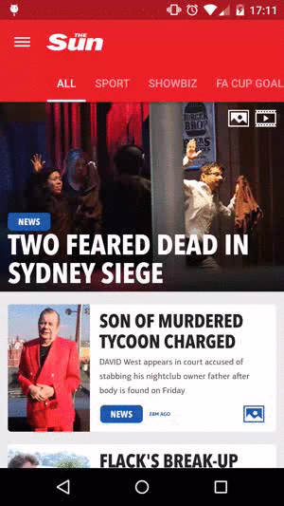
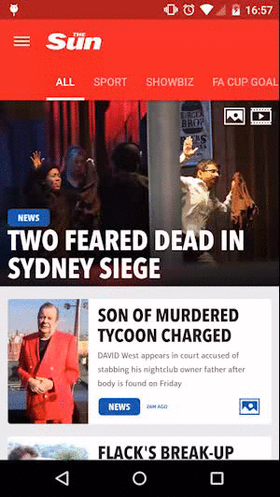
Google·Design¬
Google·Design¬
Holo·Design¬
3.0
Material·Design¬
5.0

Slide 2
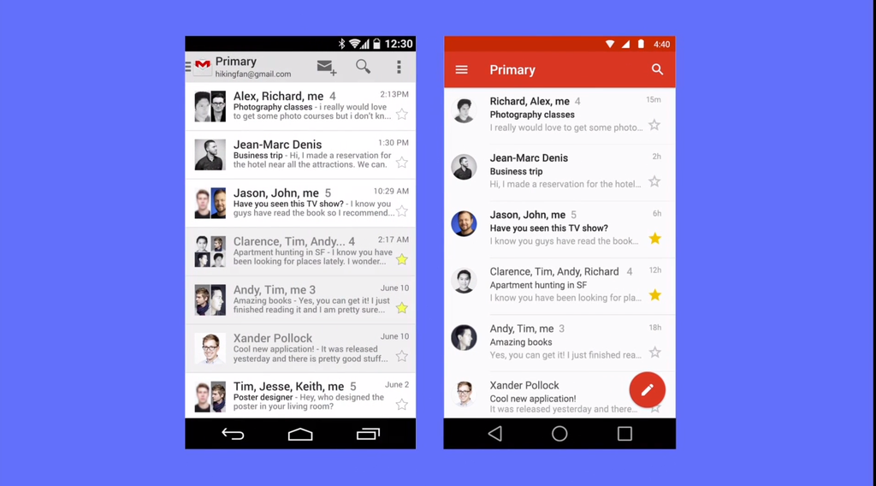
Google·Design¬

Slide 3
Material Design Guideline
Material Resources
Material Videos
Tools Introductions
Tips for Design
……
Google·Design¬
design.google.com
跨平台

Slide 4
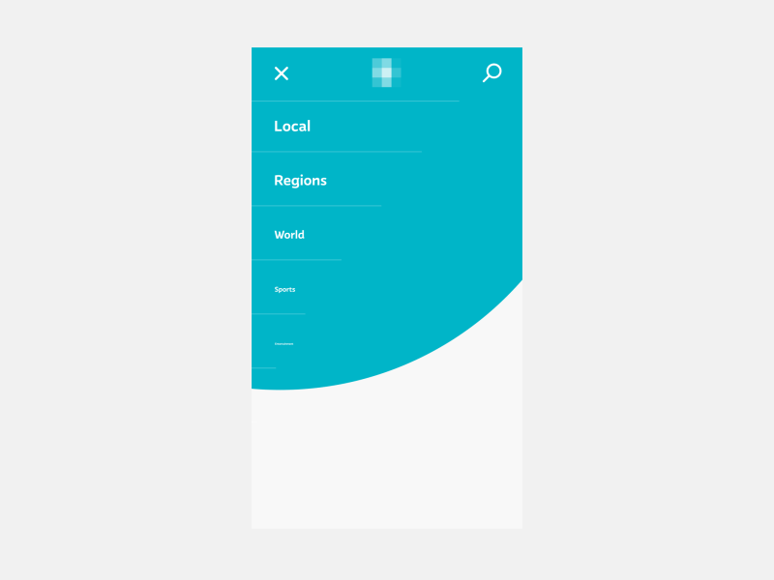

Material·Design¬
色彩
动画
光影

Slide 5
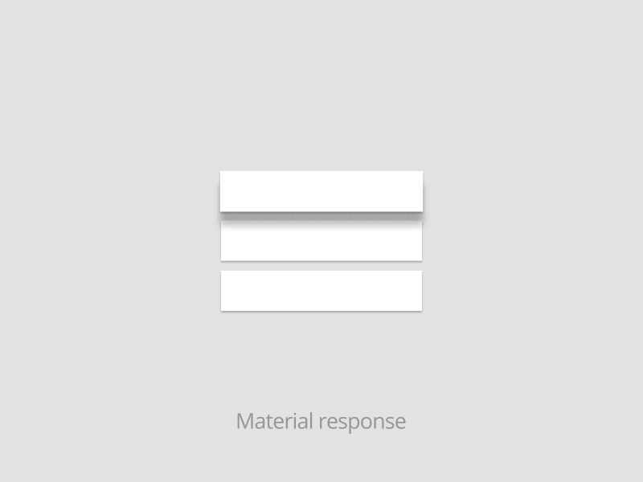
Material·Design¬
响应式交互
水墨扩散
似纸非纸
非线性加速

Slide 6
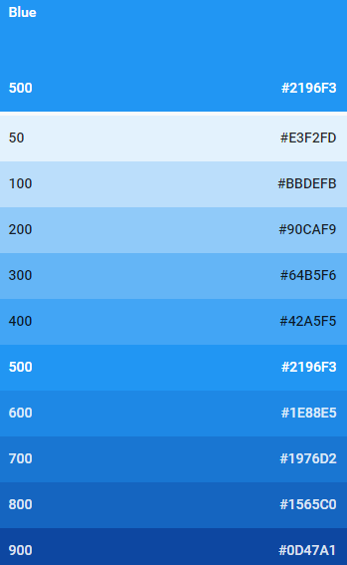

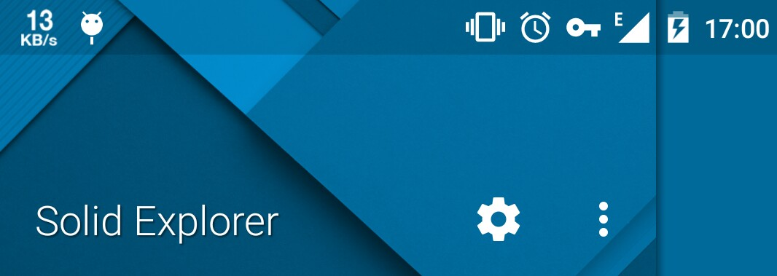

Material·Design·Color¬
Primary 500
Status Bar 700

Slide 7
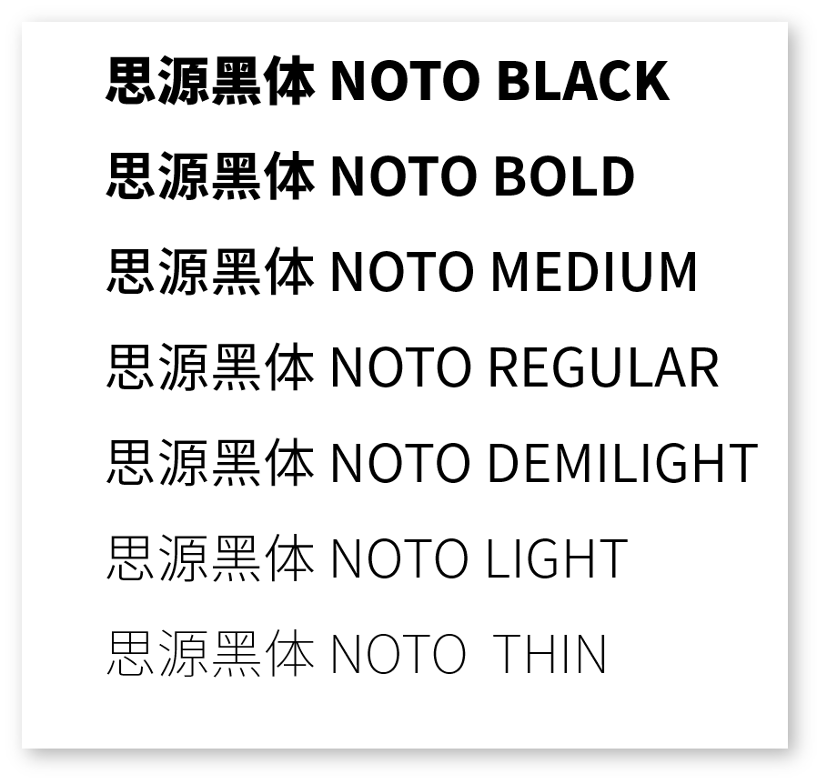
Google·Design¬
Fonts

Slide 8
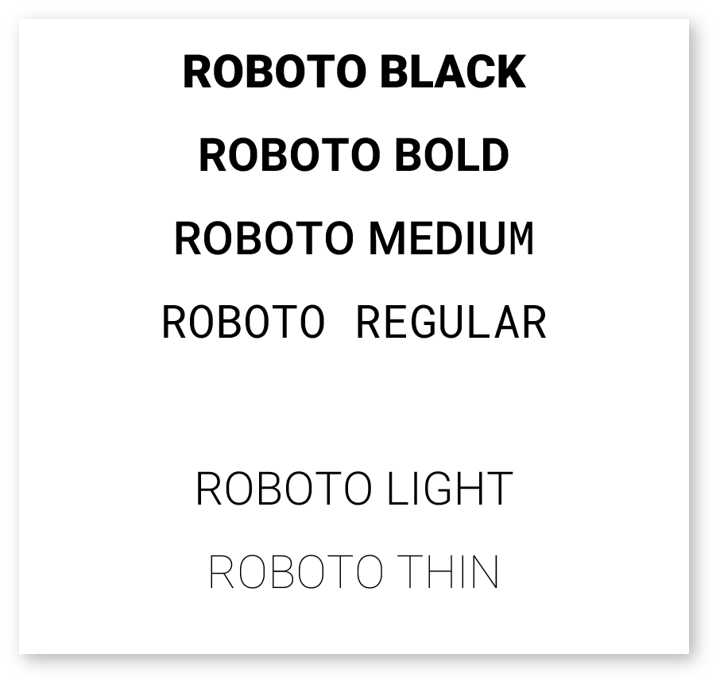
Material·Design·Fonts¬
6个字重
7个字重

Slide 9

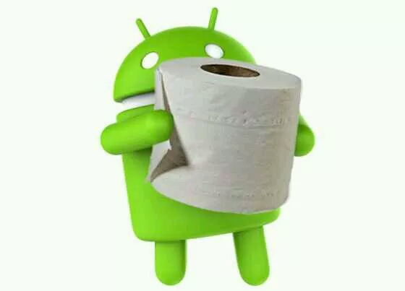

Thank·You¬
Ingress Resistance LV.10 @ywtesi23

